Slide 1
Introduction to
Software Design Thinking
Module 1 (09)
216U01E701
Software Design Thiniking
July- Dec 2026

Slide 2
Module 1: Introduction to
Software Design Thinking
Concept of design thinking in Software Engineering
Stages: Empathize, Define, Ideate, Prototype, Test
Human-centered software design approach
Design vs. traditional problem-solving
Case studies on successful design thinking in software

Slide 3
Design Thinking in Software Engineering
Designing a product:
Building a home (Stakeholders):
Civil Engineer
Architect
Interior Designer
Home Owner
End users ( House Wife, Children, Elder People)

Slide 4
Design Thinking in Software Engineering
Stake Holder | POV ( point of View) Interest
Civil Engineer | Stability, Safety
Architect | Standards
Interior Decorator | Aesthetics
Home Owner | Return on Investment
House Wife | Efficiency, maintenance, management
Children | Facilities, Entertainment
Elderly People | Accessibility, Comfort

Slide 5
Design Thinking in Software Engineering
Designing a product will engage:
  An interdisciplinary team of designers, behavioural scientists, marketers, and engineers whose task was to identify appropriate constraints for the project.
Involved in the project as it passed from inspiration through ideation and on into the implementation phase.

Slide 6
Design Thinking in Software Engineering
Three spaces of innovation of a Product
  Inspiration: the problem or opportunity that motivates the search for solutions
  Ideation: the process of generating, developing, and testing ideas
  Implementation: the path that leads from the project room to the market.
Performed in iterative manner

Slide 7
Design Thinking in Software Engineering
Three spaces of innovation of a Product
  Inspiration:
    The exploratory phase where the design team immerses themselves in the world of the user to uncover problems, gather insights, and identify latent needs.
  Core Objectives of Inspiration
    Divergent Exploration: Moving away from immediate assumptions to discover new possibilities/ options.
    Uncovering Latent Needs: Identifying requirements that users themselves cannot articulate because they are so accustomed to compensating for poor design.
    Shifting Perspective: Moving from a technocentric focus ("What can our engineers build?") to a human-centered focus ("What do people actually need?").

Slide 8
Design Thinking in Software Engineering
Three spaces of innovation of a Product
  Inspiration:
  Approach:
    Watch What they DO: Will help in identifying how people use the product, where the end-user stuck …
    Listen to what they SAY: understand the user's emotional state, frustrations, and motivations.
    Experience what they FEEL: physically place themselves in the user's environment or temporarily take on their physical constraints
  Target the Extremes: Will expose the pain points, flaws which will help in providing better solution

Slide 9
Design Thinking in Software Engineering
Three spaces of innovation of a Product
  Ideation: Quantity over Quality
  one problem many solutions
  Don’t restrict to only one (few) solution but try to find as many as possible solutions

Slide 10
Design Thinking in Software Engineering
Three spaces of innovation of a Product
  Implementation: the path that leads from the project room to the market.

Slide 11
Lecture 2
Stages: Empathize, Define, Ideate, Prototype, Test

Slide 12
The 5-Stage Framework
Empathize: Understand user needs and research their real-world problems.
Define: Synthesize research and frame a clear, actionable problem statement.
Ideate: Generate a wide range of creative solutions without initial judgment
Prototype: Build low-fidelity versions of ideas to quickly learn and iterate.
.
Test: Gather feedback from real users to validate and refine the concept.

Slide 13











The 5-Stage Framework
Empathize
Define
Ideate
Prototype
Test
Understand user needs and research their real-world problems.
Synthesize research and frame a clear, actionable problem statement.
Generate a wide range of creative solutions without initial judgment.
Build low-fidelity versions of ideas to quickly learn and iterate.
Gather feedback from real users to validate and refine the concept.

Slide 14
01. Empathize
Understand the User
Empathy is the foundation of human-centered design. It requires setting aside your own assumptions to gain deep insights into users and their needs.
By conducting interviews and mapping empathy, we uncover not just what people do, but how they think and feel.

Slide 15
Methods for Empathy
Observation & Shadowing: Watch users in their natural environment to see pain points that they might not even notice themselves.
Deep Dive Interviews: Ask "Why?" repeatedly to move past surface-level answers and discover latent needs and motivations.
Immersion: Step into the shoes of the user by experiencing their journey firsthand, feeling the frustrations and successes they face.

Slide 16
02. Define
Framing the Challenge
In this phase, you synthesize your research from the Empathize stage to define the core problem you are trying to solve.
The goal is to create a "Point of View" (POV) that is human-centered, focusing on specific users and their needs rather than business goals.
"How Might We encourage healthier eating habits for busy office workers during their lunch break?"

Slide 17
03. Ideate
Expanding the Possible
Now that the problem is defined, it's time to generate solutions. The key to successful ideation is volume over quality in the beginning.
We use creative triggers and brainstorming rules to bypass self-censorship and encourage wild ideas that might lead to breakthroughs.
Defer judgment.
Encourage wild ideas.
Build on the ideas of others.

Slide 18
Ideation Techniques
Brainstorming
Brainwriting
A collaborative, verbal method where the group discusses and builds ideas together out loud. Great for building momentum and energy in the room.
Individuals write ideas silently on sticky notes before sharing. This prevents "groupthink" and ensures everyone's voice is heard equally.
Pro: High energy and immediate feedback.
Pro: Eliminates bias and captures diverse thoughts.

Slide 19
04. Prototype
Building to Learn
Prototyping is about making ideas tangible. You don't need a high-tech lab; you just need to create something users can interact with.
Low-fidelity prototypes—sketches, paper models, or wireframes—allow for rapid iteration without heavy investment of time or money.
The motto: "Fail fast to learn faster."

Slide 20
05. Test
Validation & Feedback
Testing is where you put your prototype in front of real users. Observe their interactions, listen to their feedback, and watch for friction points.
This isn't about selling your idea; it's about validating if your solution actually solves the problem you defined in Stage 2.
Insights gained here often lead to refining the prototype or even redefining the problem entirely.

Slide 21
The Iterative Cycle
Design thinking is non-linear. Insights from one stage often trigger a return to an earlier one.
Insights
Redefine
Iterate
Refine
Launch
User research reveals a new need.
Adjust the POV based on data.
Pivot the solution strategy.
Update prototypes for clarity.
Implement with user confidence.

Slide 22
Stages in Design Thinking
Stages:
  Empathize
  Define
  Ideate
  Prototype
  Test

Slide 23
Stages in Design Thinking
Stages: Empathize, Define, Ideate, Prototype, Test

Slide 24
Lecture 3
Human Centered Software Design

Slide 25
Human Centred Software Design
Human-Centred Software Design (HCD) shifts the focus of software engineering from technology-first (What can we build?) to people-first (What do users actually need, and how can we make it effortless for them?).
Instead of forcing users to adapt to how software works, HCD forces the software to adapt to human behavior, cognitive limits, and emotions.

Slide 26
Human Centred Software Design
The 4 Core Principles of HCD
Focus on People:
  Always design with a deep empathy for the actual end-users—understanding their environment, daily frustrations, and workflows.
Fix the Root Problem:
  Don't just build what users say they want; observe them to discover the true, underlying friction they face.

Slide 27
Human Centered Software Design
The 4 Core Principles of HCD
Everything is a System:
  Recognize that software doesn't exist in a vacuum. A user's experience includes their device, their internet speed, their physical surroundings, and their organizational processes.
Iterate Continuously:
  Accept that your first design won't be perfect. Test early, fail fast, and refine continuously based on real human feedback.

Slide 28
Human Centred Software Design
Human-Centred Software Design (HCSD) is an approach to designing software that
  Prioritizes the needs
  Goals,
  Abilities,
  Experiences of the people who will use it.
Instead of starting with technology or features, it begins by
  Understanding users
  Designing solutions that are useful,
  Usable
  Accessible.

Slide 29
Human Centred Software Design
Key Characteristics
  User-focused
  Empathy-driven
  Iterative
  Evidence-based
  Accessible
  Collaborative

Slide 30
Human Centred Software Design
Principles of Human-Centred Software Design
  Understand users – Research users' needs, behaviours, and challenges through interviews, surveys, observation, and usability studies.
  Involve users throughout the process – Gather user feedback during planning, design, development, and testing.
  Focus on usability – Ensure the software is easy to learn, efficient to use, and minimizes errors.
  Iterative design – Continuously improve the product based on user feedback and testing.
  Accessibility and inclusivity – Design for people with different abilities, backgrounds, languages, and levels of technical experience.

Slide 31
Human Centred Software Design
Case 1:
Canteen
  Personas:
    Students
    Faculty/ Staff
    Suppliers
    Cashiers
    Counter Staff
    Cook
    Table Cleaner

Slide 32
Human Centred Software Design
Case 1:
Canteen
Facilities:
  Too much crowd
  Cleanliness
Food Order System:
  Queue in the canteen for making payment
  Waiting time for getting food ready
  Not knowing if your food is ready

Slide 33
Human Centred Software Design
Merits:
  Improves user satisfaction.
  Increases productivity and efficiency
  Reduces user errors and training requirements
  Enhances accessibility and inclusiveness
  Lowers development costs by identifying problems early
  Increases adoption and customer loyalty.

Slide 34
Human Centered Software Design

Slide 35
Lecture 6-7

Slide 36
Crystal Ball approach in design
A strategic foresight exercise where a design team attempts to predict future user behaviours, technological shifts, and market environments 5 to 10 years down the line.
Like a fortune teller looks into a crystal ball to see the future, designers use trend data, emerging tech signals, and cultural shifts to design products for a world that does not yet fully exist

Slide 37
Reactive / Continuous Deployment approach in design
Focuses entirely on the present moment, real-time data, and immediate user behaviour.
Find what people face issues, or looking for solution and provide the solution

Slide 38
Comparison
Feature | Crystal Ball | Reactive/ Real Time approach
Data for development | Qualitative macro-trends, foresight signals, futures cones, and expert speculation | Quantitative telemetry, live A/B test data, crash logs, and immediate customer support tickets
Product Lifecycle | Long, slow, and highly strategic research-and-development phases. | Hyper-fast, continuous release cycles (daily or weekly patches and micro-updates).
Risk Profile | High Risk, High Reward: You could invent the next iPhone, or you could end up with a Google Glass | Low Risk, Low Reward: You rarely fail catastrophically, but you risk making only minor, uninspiring changes.
Example | Automotive Concept Cars | Social Media Platforms

Slide 39
Approach to Design
10 Tools for Designing
Visualization
Journey Mapping
Value Chain Analysis
Mind Mapping
Brainstorming
Concept Development
Assumption Testing
Rapid Prototyping
Customer co-creation
Learning Launch

Slide 40
Approach to Design
1. Visualization: using imagery to envision possibilities and bring them to life
2. Journey Mapping: assessing the existing experience through the customer's eyes
3. Value Chain Analysis: assessing the current value chain that supports the
customer's journey
4. Mind Mapping: generating insights from exploration activities and using those to create design criteria
5. Brainstorming: generating new possibilities and new alternative business models
6. Concept Development: assembling innovative elements into a coherent alternative solution that can be explored and evaluated
7. Assumption Testing: isolating and testing the key assumptions that will drive the success or failure of a concept
8. Rapid Prototyping: expressing a new concept in a tangible form for exploration, testing, and refinement
9. Customer Co-Creation: enrolling customers to participate in creating the solution that best meets their needs
10.Learning Launch: creating an affordable experiment that lets customers experience the new solution over an extended period of time, to test key assumptions with market data

Slide 41
Approach to Design
Visualization
Integral to the other tools.
Focus on identifying, organizing and communicating things rather than describing in text and numbers
Visual imaginary into work process that focuses on bringing idea to life.

Slide 42
Approach to Design
Visualization
  The process of using visual imagery and diagrams to convey ideas and envision possibilities.
  Shifts team communication away from abstract words and dense text toward concrete visual formats.
  Using sketches, diagrams, and storyboards makes complex concepts immediately accessible and easier to grasp.
  Helps bridge communication gaps between multidisciplinary team members who speak different technical languages.
  Allows teams to bring abstract ideas to life before investing actual resources.

Slide 43
Approach to Design
Visualization
  Stimulates creative thinking and encourages non-linear problem-solving during discussions.
  Teams can quickly identify missing elements or logical flaws in a concept when laid out visually.
  Enhances empathy by making customer scenarios and emotional reactions visually apparent.
  Visual artifacts serve as continuous visual reference points throughout the entire design process.

Slide 44
Approach to Design
2. Journey Mapping
  An analytical tool used to track and evaluate a customer’s experience over time.
  Explicitly assesses the current, end-to-end process strictly through the customer's eyes.
  The map captures every touchpoint, action, and interaction a user has with a product or service.
  Highlights emotional highs and lows, revealing key pain points and areas of customer frustration.
  Teams use it to uncover hidden moments of truth where customer loyalty is gained or lost.

Slide 45
Approach to Design
2. Journey Mapping
  Shifts the internal corporate perspective to an empathetic, customer-centric point of view.
  Process exposes gaps between what a company thinks it delivers and what users actually experience.
  Helps prioritize areas that require immediate operational improvement or innovative redesign.
  Provides context, showing how individual interactions fit into a broader experience.
Lays the groundwork for identifying meaningful opportunities for value creation.

Slide 46
Approach to Design
3. Value Chain Analysis
  Examines the enterprise operations that support the customer journey.
  Tries to find out the behind the scenes at the internal capabilities, resources, and operational workflows involved.
  Focuses on understanding how value is created, delivered, and sustained across partners and suppliers.
  Identifies which internal processes directly contribute to solving customer pain points.
  Analysis reveals operational bottlenecks, redundancies, and cost inefficiencies within the organization.

Slide 47
Approach to Design
3. Value Chain Analysis
Assesses how flexible the current value chain is to support potential new solutions.
Teams gain clarity on key capabilities required to turn a new design concept into reality.
Evaluates strategic relationships with external vendors and ecosystem partners.
The tool ensures that proposed front-end customer experiences are backed by sustainable back-end operations.
Bridges customer-facing desirability with operational and financial feasibility.

Slide 48
Approach to Design
4. Mind Mapping
  A visual technique used to synthesize insights gathered during research and exploration.
  Unstructured research data—like user interviews and observations—and organizes it visually.
  The process displays central themes radiating outward into related sub-ideas and patterns.
  Allows teams to uncover meaningful relationships, clusters, and underlying customer insights.
  By connecting disparate data points, mind mapping helps teams make sense of complex qualitative input.

Slide 49
Approach to Design
4. Mind Mapping
  The insights generated from the map are directly used to form actionable design criteria.
  Design criteria act as explicit guidelines defining what a successful future solution must accomplish.
  Prevents teams from rushing to solutions before thoroughly understanding the problem space.
  Keeps the entire research context visible during the transition to ideation.
It serves as a bridge between the exploration phase and the generation of creative ideas.

Slide 50
Approach to Design
5. Brainstorming
  An ideation practice designed to generate a broad array of novel possibilities.
  Focuses on exploring diverse alternative solutions and completely new business models.
  The primary rule during initial brainstorming is to defer judgment and emphasize quantity over quality.
  Encourages divergent thinking, pushing participants beyond obvious or incremental fixes.
  Wild, unconventional ideas are actively welcomed to expand the boundaries of possibility.

Slide 51
Approach to Design
5. Brainstorming
  Group dynamics allow participants to build on, combine, and refine each other's ideas.
  Creates a safe psychological space where innovative, high-risk concepts can surface.
  Challenges standard industry assumptions and established organizational norms.
  The resulting pool of ideas provides rich raw material for subsequent solution filtering.
It opens up fresh pathways for value creation that were previously unconsidered.

Slide 52
Approach to Design
6. Concept Development
  Takes raw ideas from brainstorming and crafts them into coherent solutions.
  Combines separate innovative elements, features, and business logic into complete packages.
  Each developed concept represents a distinct, alternative way to solve the identified customer problem.
  Concepts are articulated clearly so they can be easily evaluated, compared, and debated.
  Involves defining the customer value proposition and basic underlying business model.

Slide 53
Approach to Design
6. Concept Development
  Teams assess each concept for its desirability, feasibility, and financial viability.
  Weak or redundant elements are filtered out, while promising features are integrated.
  Provides structured options for stakeholders to review before building physical prototypes.
It transforms scattered ideas into well-defined hypotheses ready for testing.

Slide 54
Approach to Design
7. Assumption Testing
  Systematically isolates the critical beliefs underlying a concept's success.
  Identifies key hypotheses regarding customer behavior, technical feasibility, and financial viability.
  The goal is to highlight high-risk assumptions that could cause the entire concept to fail.
  Instead of building the full product, teams ask what must be true for this idea to work.
  Assumptions are prioritized based on their level of uncertainty and potential impact on failure.

Slide 55
Approach to Design
7. Assumption Testing
  It provides a structured methodology to test these critical beliefs quickly and cheaply.
  The process reduces biases, such as overconfidence in an unproven business idea.
  Testing assumptions early prevents teams from investing heavily in flawed concepts.
  Data gathered from preliminary tests validates or invalidates core project premises.
Transforms blind faith into evidence-based decision-making.

Slide 56
Approach to Design
8. Rapid Prototyping
  A new concept in a physical or tangible form very quickly.
  Prototypes can include low-fidelity materials like paper mockups, storyboards, or digital wireframes.
  The emphasis is on speed and low cost rather than producing a polished, finished product.
  Making ideas tangible allows teams and users to interact with concepts directly.
  Serves as a tool for exploration, gathering real-time feedback, and driving iterative refinement.

Slide 57
Approach to Design
8. Rapid Prototyping
  Prototyping uncovers design flaws and usability issues early when they are cheap to fix.
  It turns abstract discussions into concrete, hands-on experiences for evaluators.
  Iterative cycles of building, testing, and refining continuously improve the product design.
  It helps build consensus among stakeholders by offering something physical to evaluate.
FAILURE early and cheaply to succeed faster in real-world application.

Slide 58
Approach to Design
9. Customer Co-Creation
  Actively enrolls target users directly into the design process.
  Rather than designing for customers, teams design solutions directly with them.
  Customers participate in hands-on workshops, feedback sessions, and solution building.
  Gives users a voice in shaping features to ensure the solution meets their real needs.
  Co-creation uncovers latent needs and preferences that traditional surveys often miss.

Slide 59
Approach to Design
9. Customer Co-Creation
  It fosters a strong sense of ownership and brand loyalty among participating customers.
  The process reduces the risk of creating products that customers do not actually want.
  Teams gain real-time, authentic reactions to proposed solution elements during development.
  It accelerates the iteration process by getting immediate customer input on design changes.
it aligns product development precisely with genuine user expectations.

Slide 60
Approach to Design
10. Learning Launch
  An affordable, real-market experiment conducted over an extended period.
  Unlike a full product launch, its primary purpose is learning rather than generating immediate revenue.
  Allows real customers to experience the new solution within their actual daily routines.
  The launch tests key business assumptions using authentic market data rather than opinion.
  It limits financial and reputational risk by keeping the initial rollout small and controlled.

Slide 61
Approach to Design
10. Learning Launch
  Teams monitor real user engagement, purchasing behavior, and retention metrics over time.
  Unexpected user behaviors and operational bottlenecks surface in real-world conditions.
  The findings provide objective evidence needed to scale, pivot, or cancel the concept.
  It bridges the gap between controlled prototype testing and full-scale commercialization.
It offers a data-driven foundation for committing major capital investments.

Slide 62
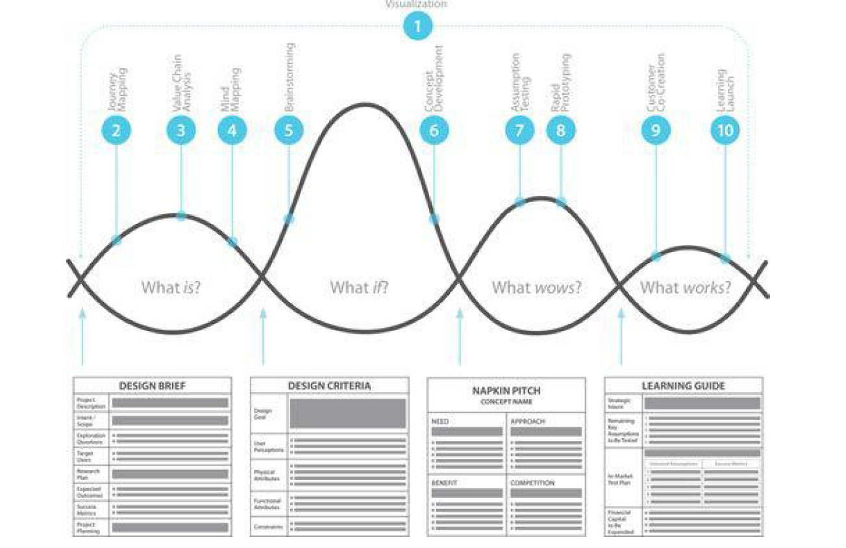

Slide 63
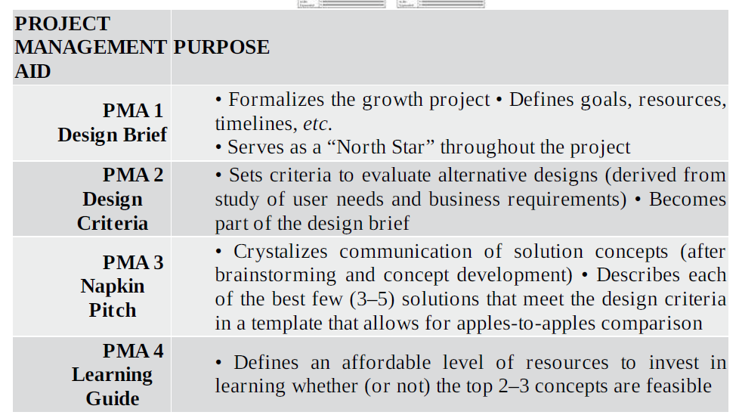

Slide 64
Approach to Design
The four stage process:
What is?
What if?
What wows?
What works?
Use for each of the above questions: broadening (diverging) progressively expanding our field of vision thinking of multiple options and narrowing (conversing) around narrowing down options to most promising

Slide 65
Case Studies on
Software Design Thinking
Problem-Finding vs. Problem-Solving: Design Thinking identifies the right problem to solve, while Agile/Scrum provides the software framework to build the solution incrementally.
Dual-Track Agile: Leading software organizations run a Discovery Track (Design Thinking) in parallel with a Delivery Track (Agile Sprints) to test assumptions before writing production-level code.

Slide 66
Case Studies on
Software Design Thinking
Netflix: Evolving the Digital Entertainment Experience
When transitioning from physical DVD shipping to digital streaming, Netflix continuously relied on Design Thinking to redefine its user interface and core platform experience.
Empathize & Define: Netflix observed user behavior in living rooms and noticed major friction points: decision fatigue (endless browsing without choosing) and the hassle of waiting for content to stream or load.
Ideate & Prototype: Product teams ideated ways to streamline recommendations, creating visual preview reels, personalized algorithm-driven thumbnails, and a seamless continuous-play mechanism.
Test & Implement: They ran extensive A/B tests on UI features, leading to iconic features like the "Skip Intro" button, localized content thumbnails, and automated video previews.
Outcome: Transformed traditional media consumption by reducing the time users spend searching for content, driving world-class user retention.

Slide 67
Case Studies on
Software Design Thinking
IBM: Enterprise Software Transformation with "IBM Design Thinking“
Historically known for hardware and enterprise infrastructure, IBM suffered from fragmented, non-intuitive enterprise software suites. They invested heavily in embedding Design Thinking directly into their Agile development lifecycles.
Empathize & Define: Developer and design teams shadowed enterprise users in their workplaces. They realized enterprise software was overly complex compared to consumer apps, leading to long onboarding times and user errors.
Ideate & Prototype: IBM replaced traditional specification documents with visual "Playback" sessions and user journey blueprints. Developers worked alongside designers to build low-fidelity interactive prototypes early in the release cycle.
Test & Implement: Instead of shipping massive yearly updates, they implemented "Design System (Carbon)" components integrated with two-week Agile sprints.
Outcome: Drastically reduced development and release cycles, cut product rework, and created a unified user interface across their entire SaaS portfolio.

Slide 68
Case Studies on
Software Design Thinking
Airbnb: Saving the Platform from Failure
In 2009, Airbnb was barely generating revenue and on the verge of bankruptcy. The founders realized their underlying code and software platform were fine, but the user-facing product experience was failing.
Empathize & Define: The team traveled to New York to personally meet hosts and view property listings on the site. They realized users weren't booking rooms because the property photos—uploaded by hosts—were low-quality, dark, and uninviting.
Ideate & Prototype: They bypassed traditional engineering code sprints and tried a non-scalable, hands-on experiment: renting a camera to take high-resolution, professional photos of listings.
Test & Implement: They replaced the low-quality pictures on the live application with professional photographs to test if visual quality impacted booking rates.
Outcome: Revenue doubled almost immediately ($200 to $400 per week), proving that solving human experience issues via Design Thinking yields immediate technological ROI.

Slide 69
Case Studies on
Software Design Thinking
American Family Insurance & IDEO: "Moonrise" On-Demand App
American Family Insurance wanted to build a digital solution to help working-class families improve their financial health.
Empathize & Define: Initial business assumptions suggested users needed budgeting or financial tracking software. However, user interviews revealed that families already budgeted tightly—their real issue was handling unexpected financial shocks (e.g., medical bills or car repairs).
Ideate & Prototype: Instead of an expense-tracking app, the team ideated an on-demand labor software platform matching workers with micro-shifts, offering payout immediately upon shift completion.
Test & Implement: They prototyped the app functionality using a basic SMS text messaging system before writing complex backend code, validating worker demand and business interest.
Outcome: The pilot evolved into Moonrise, a successful startup application that fulfilled thousands of shifts and provided flexible earnings directly to families in need.

Slide 71
Module 1: Introduction to
Software Design Thinking
SCAMPER
A powerful acronym framework used to modify existing products into new innovations:
Substitute (What materials or components can we swap?)
Combine (Can we merge this product with another service?)
Adapt (How can we tweak this for a completely different industry?)
Modify/Magnify (What happens if we make a core feature 10x bigger?)
Put to another use (How would a child or an elder use this product?)
Eliminate (What can we remove to simplify the interface entirely?)
Reverse (What if we flip the user journey upside down?)

